Slide 1
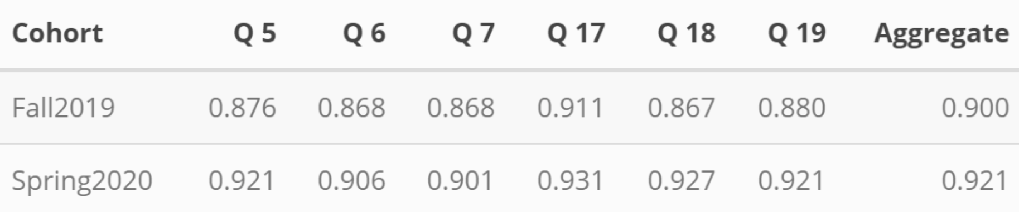

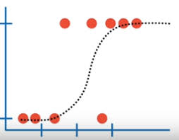
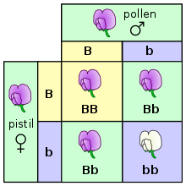
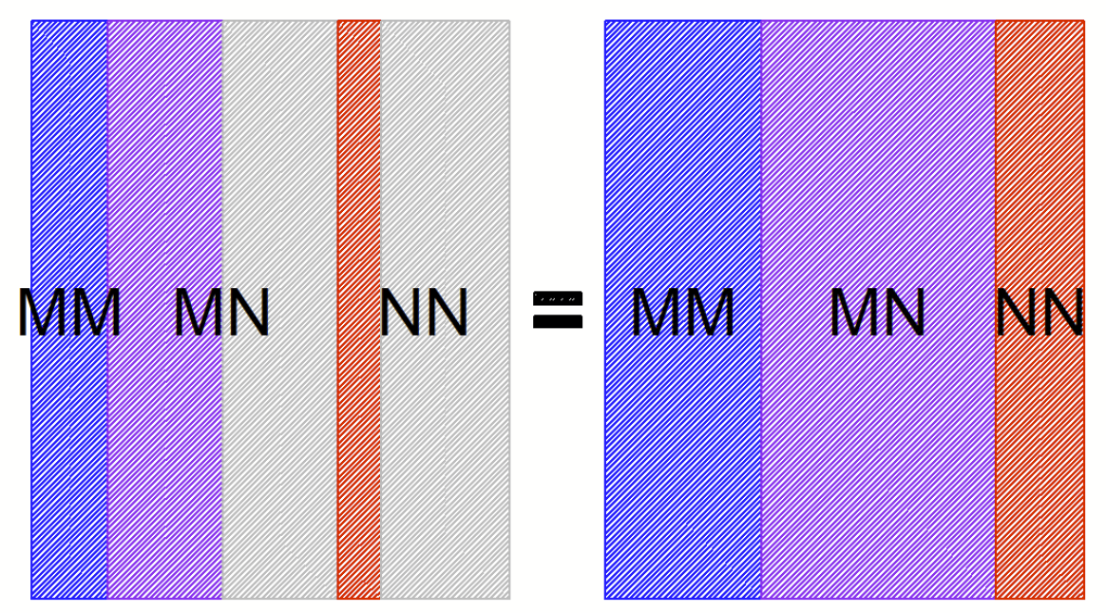
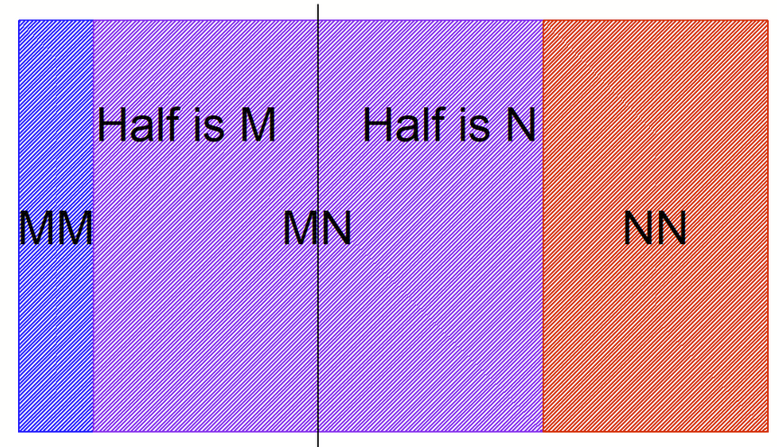
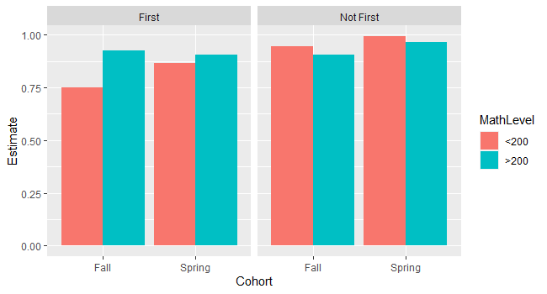
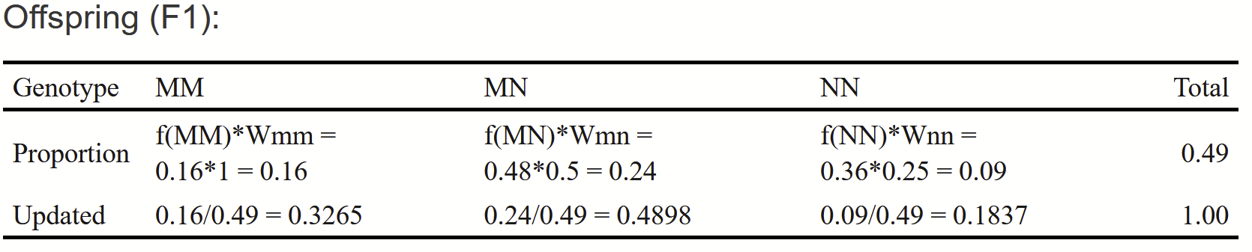
Using Visuals to Improve Quantitative Literacy Outcomes in Principles of Genetics (GN 311)
Introduction
Design
Findings
Through an interdisciplinary partnership we developed assessment measures and data visualization activities to improve student learning in GN 311 around a quantitative literacy topic.
Quantitative literacy is one of NC State’s General Education Competencies (called the “Pack Proficiencies”).
Intervention 1:
Creation of visual representations of proportions and population frequencies.
BOTTOM LINE HERE-
Quantitative literacy (QL) requires contextualized reasoning with quantities and refers to the ability to interpret data and to reason with numbers within real-world problems.
Assessment
Plan
Intervention 2:
A step-by-step walkthrough of the statistical test for Hardy-Weinberg Equilibrium
Proportion of correct answers on questions of interest for the Fall (non-intervention) and Spring (intervention) groups.
Intervention 3:
Creation of an interactive application that allowed students to generate new offspring and see how the population frequencies changed over time
Background
Logistic regression analysis included predictor variables: Pre/Post Intervention Cohort
MathLevel (highest math course taken (>200 or <200) (MathLevel)
FirstGenStatus (1st generation, Not 1st)
First order interactions
Instructors of GN 311 (Principles of Genetics) identified trouble areas in quantitative literacy including students’ understanding of the basics of population genetics.
Students had difficulty conceptualizing frequencies of phenotypes and genotypes in a population and how those frequencies behave over time.
Program faculty in Genetics partnered with faculty in Statistics (the “Pack Proficiencies” QL Champion) and the Office of Assessment to design and assess an intervention to improve learning of probability.
Example visuals from the intervention
Cohort had a p-value of about 0.1 or less in all models - Q5, Q17, and Q18 much smaller
Enrollment in previous math course >200 level associated with better performance on Q5, Q6, Q17, & Q18
FirstGenStatus important for Q5, Q6, Q7, & Q17
Q17: three-way interaction important.
Improvement for First Gen with < MTH200
Methods
Table showing the calculations behind the visuals
The team developed an assessment plan which included: identifying the timing of interventions, selecting appropriate measures, and analysis design (descriptive statistics; logistic regression).
The interventions were centered on Population genetics, Hardy Weinberg equilibrium and natural selection.
Student performance post-intervention was compared to performance in previous terms and disaggregated using a number of demographics and student characteristics to better identify performance patterns.
Assessment Questions
Q4
What is the expected number of BB plants?
Conclusions
Q5
What is the expected number of BR plants?
Significant interactions were present implying that the effect of the intervention differed depending on MathLevel and FirstGenStatus in some cases
Implications
Q6
What is the expected number of RR plants?
Q7
What is the calculated chi square value?
Q17
What is the frequency of black beetles after selection?
Q18
What is the frequency of brown beetles after selection?
Q19
What is the frequency of white beetles after selection?
Dr. Justin Post, Department of Statistics
Dr. Whitney Jones, Biologial Sciences
Samantha Rich, DASA Assessment
Dr. Stephany Dunstan, Office of Assessment and Accreditation
Shoutout to funding source and other PIs????
Notes:
This is a nice resource (https://projects.ncsu.edu/project/posters/index.html)

Slide 2
Justin’s notes
Methods:
We did an intervention around the topic of population genetics; specifically Hardy Weinberg equilibrium, a statistical test for whether or not a population has achieved HW equilibrium, and population genotype frequencies when certain genotypes are favored (selection).
Intervention consisted of:
The creation of visual representation of the proportions and population frequencies.
A step-by-step walkthrough of the concept and details of the statistical test.
An interactive application that allowed students to generate new offspring and see how the population frequencies changed over time.
As to not change the standard instruction of the material, the intervention was done in the corresponding lab section of the course.
Lab sections were led by Teaching Assistants that were instructed on the purpose of the activity and points of emphasis.
Relevant homework questions administered as a moodle quiz were recorded for the semester with the intervention as binary indicators of correct/incorrect. These were compared to the same questions from the previous semester without the intervention.
Intervention occurred in the time between homework 2 and homework 6 of the course.

Slide 3
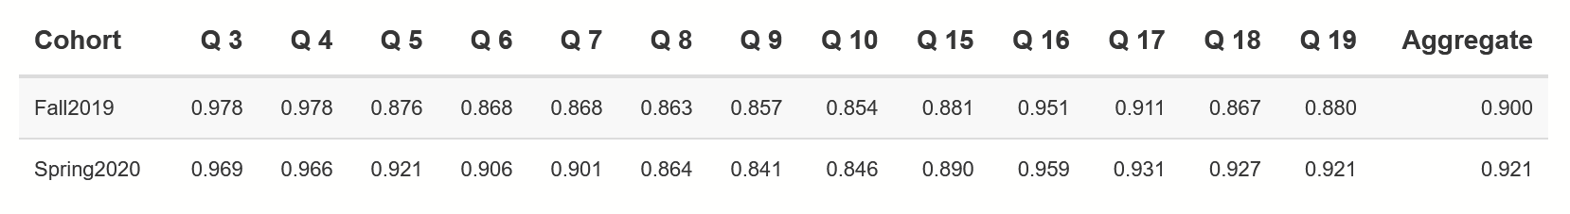
Justin’s notes
Findings:
In analyzing the data, we compared homework questions across semesters (Cohort)
The proportion of correct responses for the relevant questions are given below (spring2020 is the intervention semester): (remove 8-10 as they weren’t focused on)
Averaging over all variables, the differences seen in Q18 and Q19 had p-values of 0.0346 and 0.0520, respectively (created using a logistic regression with Cohort as the explanatory variable). The other differences were not significant.
To further investigate, other possibly relevant variables where considered:
highest math course taken (>200 or <200) (MathLevel)
transfer status (TransferStatus) (only showed importance in Q17)
rural status(RuralStatus) (only showed importance in Q16)
first gen status (FirstGenStatus)

Slide 4
Justin’s notes
Findings continued:
(I think we should put the actual questions somewhere for the questions we focus on in the findings part.)
(We can just pick what we want from this part I think)
Logistic regression models were fit for each question using Cohort and MathLevel and one other variable (TransferStatus, RuralStatus, or FirstGenStatus) with all 1st order interactions:
Automated variable selection using best subset selection (with AIC as the criteria) was conducted.
Q5 selected model had Cohort (0.047) and MathLevel (0.03) both significant
With FirstGen, Cohort (0.04), MathLevel (0.02), and Not first gen vs 1st gen showed a positive effect (first gen did worse) (0.02)
Q6 and Q7 had the same but Cohort had p-values of about 0.1 (MathLevel about 0.05)
Same as Q5 with first gen. But Q7 also showed an interaction between firstgen and mathlevel
Q17 selected model had cohort, mathlevel, first gen, many interactions are significant
Q18 had Cohort (0.01)
Q19 had Cohort (0.08)

Slide 5
Justin’s notes
Conclusions:
Cohort had a positive impact on question performance - so the intervention likely helped
Math level (<MTH 200 or >MTH200) also was important
Students that were first generation also showed some poorer performance
Anecdotally - the visuals were described as helpful by the students and TAs
Implications:
Visuals helps
Interdisciplinary work

Slide 6
Q5/6/7: Expected counts under HW equilibrium?
Q15-19: Selection questions: (15) Average fitness, (16) type of selection, (17-19) frequencies after selection
https://www4.stat.ncsu.edu/~jbpost2/GN311/HW.html
https://www4.stat.ncsu.edu/~jbpost2/GN311/Selection.html
https://shiny.stat.ncsu.edu/jbpost2/Selection/

Slide 7
Poster abstract
Quantitative literacy is one of our General Education Competencies at NC State. Quantitative literacy requires contextualized reasoning with quantities and refers to the ability to interpret data and to reason with numbers within real-world problems. Our project augmented the content delivery and student learning of quantitative ideas in GN 311 - Principles of Genetics. Past instructors identified trouble areas for students around understanding the quantitative aspects of basic population genetics. For instance, students struggled to conceptualize the idea of there being certain frequencies of phenotypes and genotypes in a population and how those frequencies behave over time. Through a cross-departmental and cross-administrative partnership, we developed assessment measures and data visualization activities to help students to see how frequencies change over time under different conditions. In comparing relevant test questions from fall 2019 to spring 2020 (pre- and post-intervention), we did see significant improvement in student performance in this area. We think this model for implementing targeted interventions through partnerships that leverage content the area expertise of faculty and assessment expertise from campus assessment professionals can be applied in other courses and disciplines to support learning in this critical General Education Competency area.

